Slide 1
Strings

Slide 2
String hashing

Slide 3
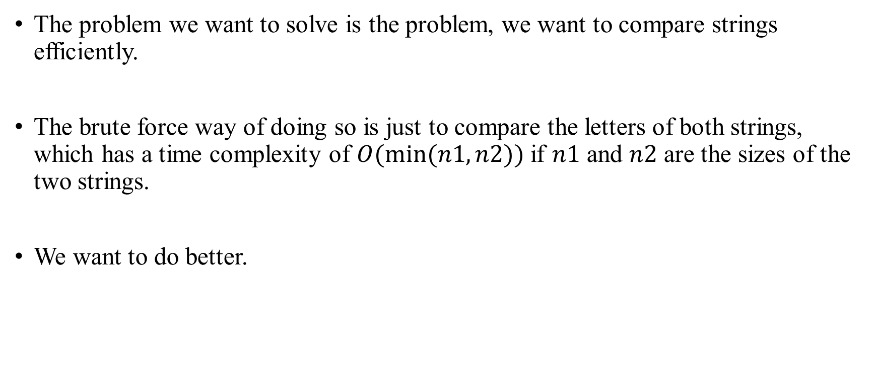
String hashing
The problem we want to solve is the problem, we want to compare strings efficiently.
The brute force way of doing so is just to compare the letters of both strings, which has a time complexity of $O(min⁡(n1,n2))$ if $n1$ and $n2$ are the sizes of the two strings.
We want to do better.

Slide 4
String hashing
The idea behind strings is the following: we convert each string into an integer, and compare those instead of the strings.
Comparing two strings is then an O(1) operation.
For the conversion we will use a hash functions.
The goal of it is to convert a string into a integer, the so-called hash of the string.

Slide 5
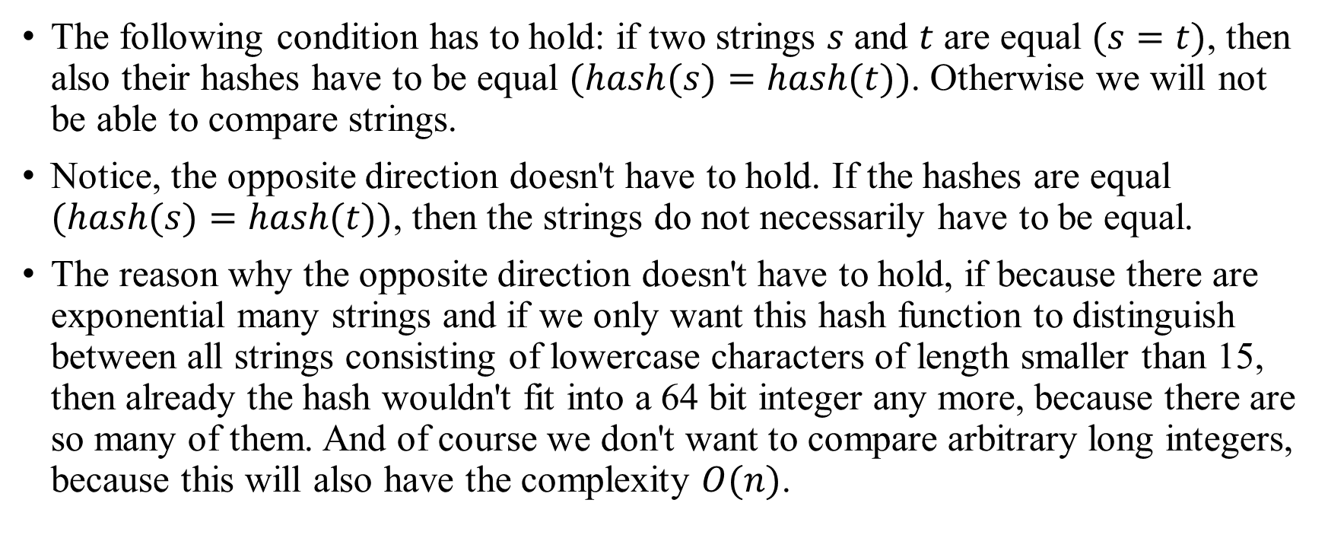
String hashing
The following condition has to hold: if two strings $s$ and $t$ are equal $(s=t)$, then also their hashes have to be equal $(hash(s)=hash(t))$. Otherwise we will not be able to compare strings.
Notice, the opposite direction doesn't have to hold. If the hashes are equal $(hash(s)=hash(t))$, then the strings do not necessarily have to be equal.
The reason why the opposite direction doesn't have to hold, if because there are exponential many strings and if we only want this hash function to distinguish between all strings consisting of lowercase characters of length smaller than 15, then already the hash wouldn't fit into a 64 bit integer any more, because there are so many of them. And of course we don't want to compare arbitrary long integers, because this will also have the complexity $O(n)$.

Slide 6
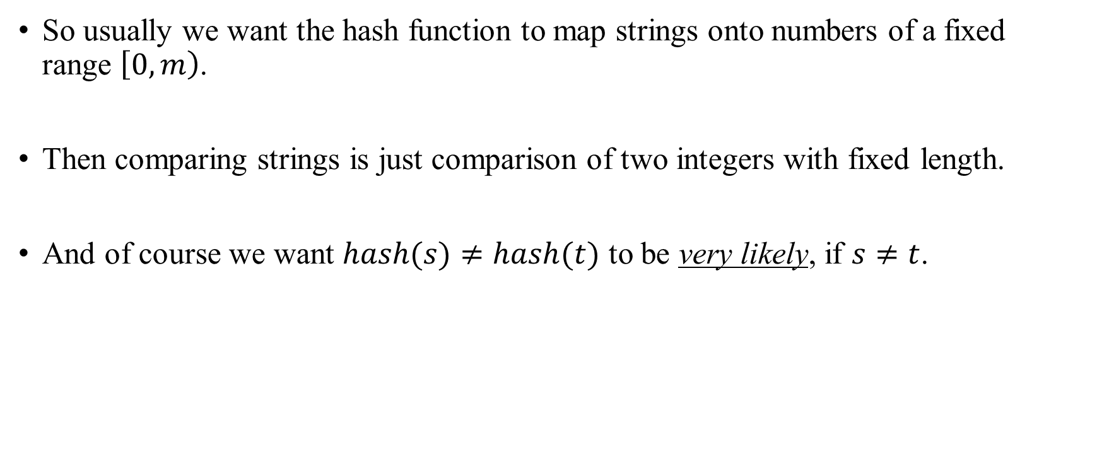
String hashing
So usually we want the hash function to map strings onto numbers of a fixed range $\left[0,m\right)$.
Then comparing strings is just comparison of two integers with fixed length.
And of course we want $hash(s)≠hash(t)$ to be very likely, if $s≠t$.

Slide 7
String hashing Collisions
Using hashing will not be 100% deterministically correct.
Two complete different strings might have the same hash (the hashes collide).
However, in a wide majority of tasks this can be safely ignored as the probability of the hashes of two different strings colliding is still very small.
And we will discuss some techniques how to keep the probability of collisions very low.

Slide 8
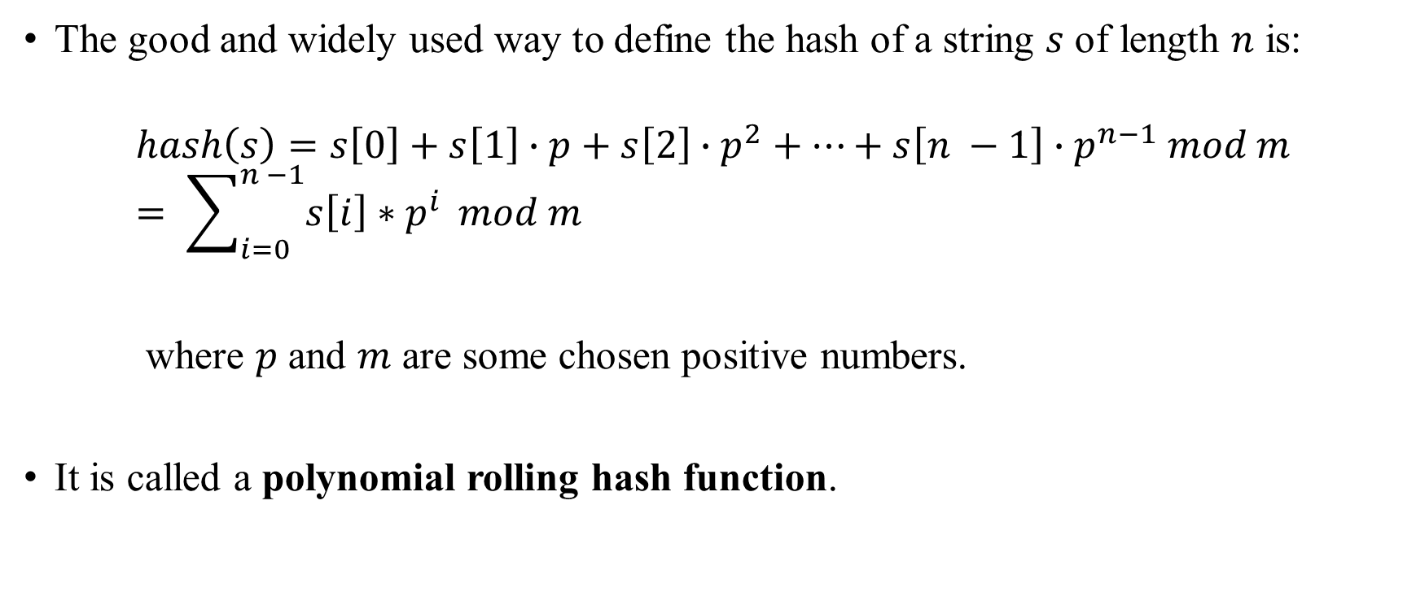
String hashing Calculation
The good and widely used way to define the hash of a string $s$ of length $n$ is:
$$hash\left(s\right)=s\left[0\right]+s\left[1\right]∙p+s\left[2\right]∙p^{2}+⋯+s\left[n −1\right]∙p^{n−1} mod m= \sum_{i=0}^{n −1}{s\left[i\right]∗p^{i}} mod m$$
where $p$ and $m$ are some chosen positive numbers.
It is called a polynomial rolling hash function.

Slide 9
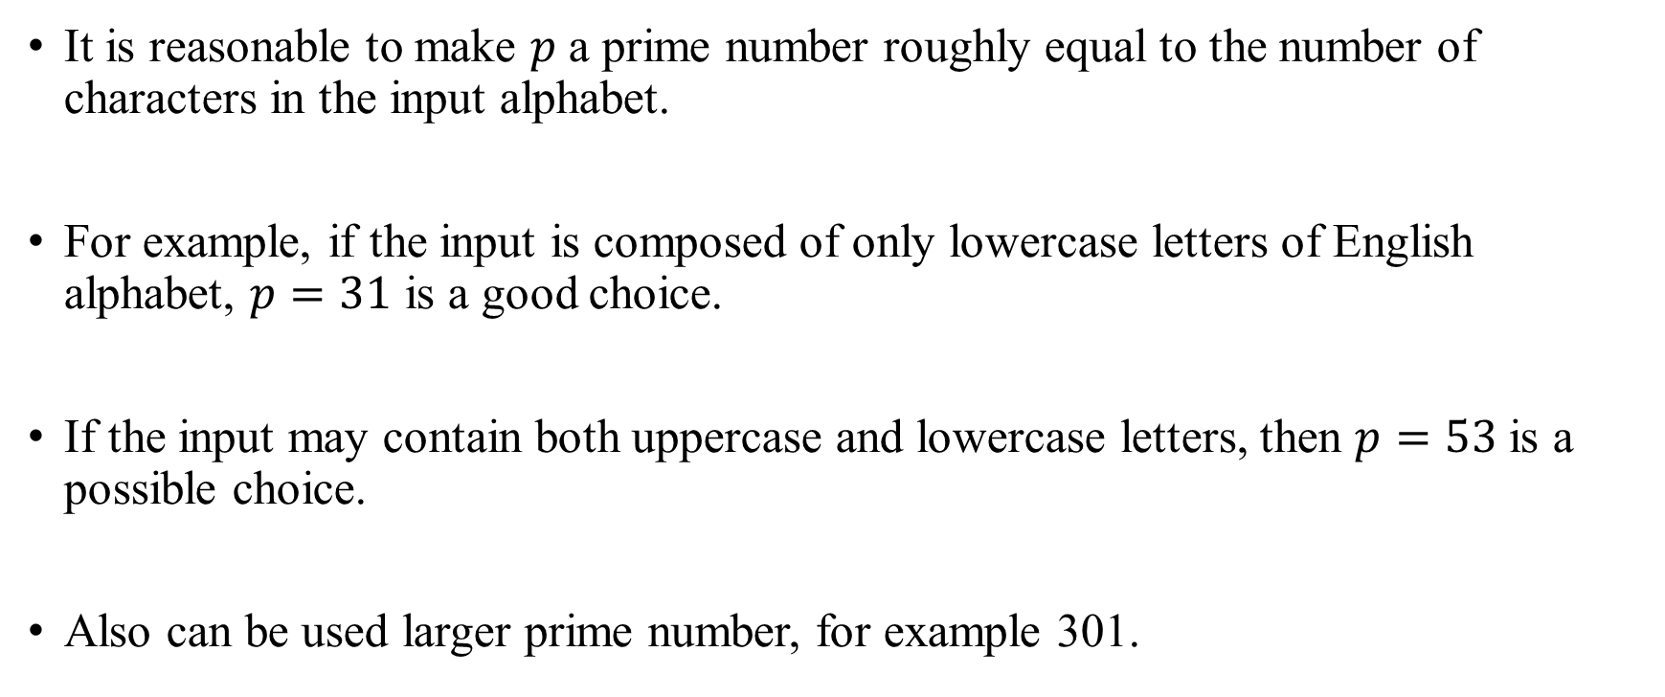
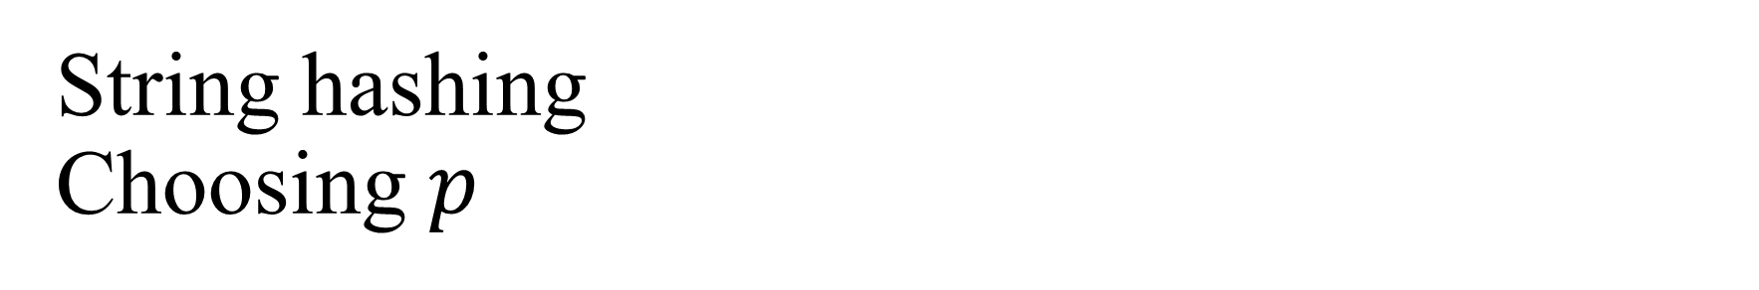
String hashing Choosing $p$
It is reasonable to make $p$ a prime number roughly equal to the number of characters in the input alphabet.
For example, if the input is composed of only lowercase letters of English alphabet, $p=31$ is a good choice.
If the input may contain both uppercase and lowercase letters, then $p=53$ is a possible choice.
Also can be used larger prime number, for example 301.

Slide 10
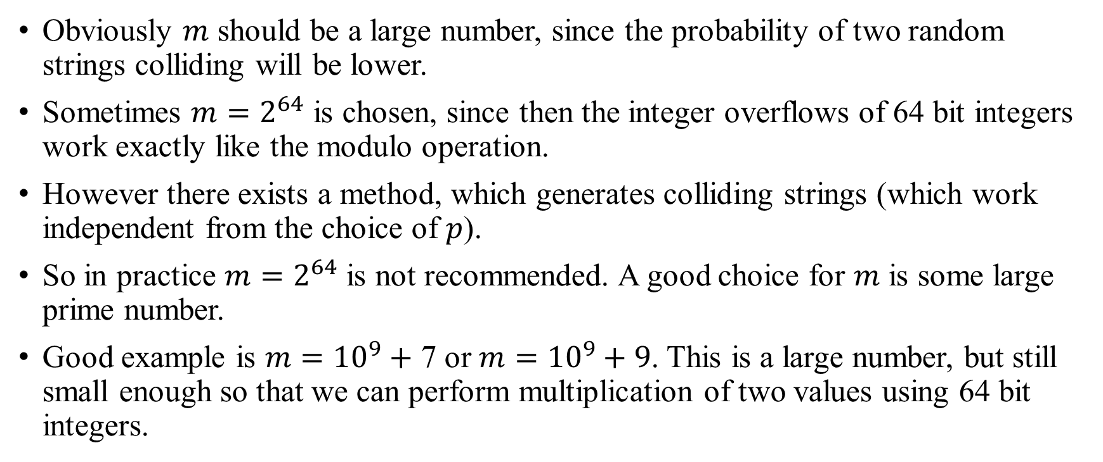
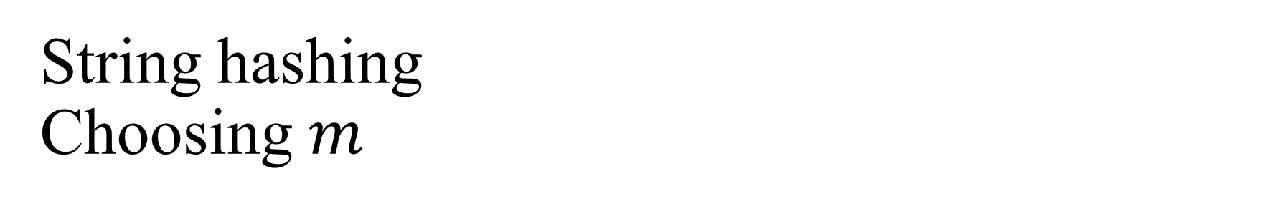
String hashing Choosing $m$
Obviously $m$ should be a large number, since the probability of two random strings colliding will be lower.
Sometimes $m=2^{64}$ is chosen, since then the integer overflows of 64 bit integers work exactly like the modulo operation.
However there exists a method, which generates colliding strings (which work independent from the choice of $p$).
So in practice $m=2^{64}$ is not recommended. A good choice for $m$ is some large prime number.
Good example is $m={10}^{9}+$ 7 or $m={10}^{9}+9$. This is a large number, but still small enough so that we can perform multiplication of two values using 64 bit integers.

Slide 11
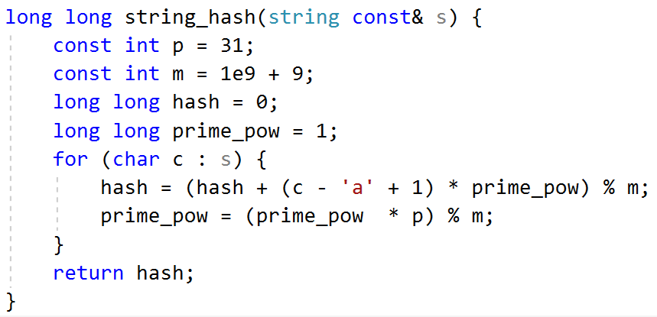
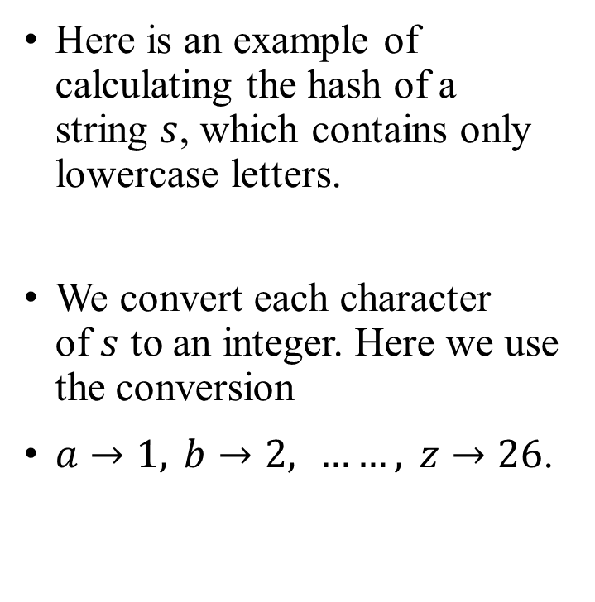
String hashing Implementation
Here is an example of calculating the hash of a string $s$, which contains only lowercase letters.
We convert each character of $s$ to an integer. Here we use the conversion
$a→1, b→2, ……, z→26$.

Slide 12

String hashing Considerations
Why converting $a→0$ is not a good idea?
Because then the hashes of the strings $a$, $aa$, $aaa$, …… all evaluate to $0$.
Precomputing the powers of $p$ might give a performance boost.

Slide 13

String hashing Fast hash of substrings of given string
Problem: Given a string $s$ and indices $i$ and $j.$
Find the hash of the substring $s[i…j]$.

Slide 14

String hashing Fast hash of substrings of given string
Hash definition:
$$hash\left(s\right)= \sum_{i=0}^{n −1}{s\left[i\right]∗p^{i}} mod m$$
So by definition, we have:
$$hash\left(s[i…j]\right)= \sum_{k=i}^{j}{s\left[k\right]∗p^{k−i}} mod m$$

Slide 15
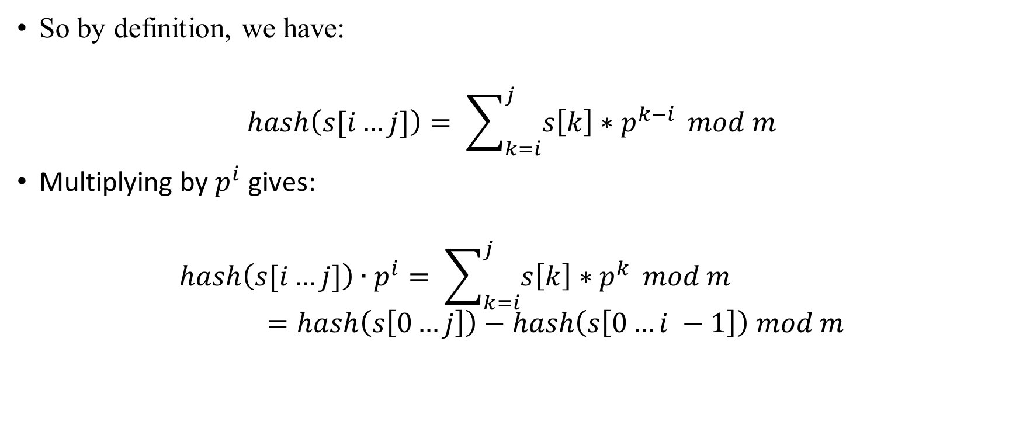
String hashing Fast hash of substrings of given string
So by definition, we have:
$$hash\left(s[i…j]\right)= \sum_{k=i}^{j}{s\left[k\right]∗p^{k−i}} mod m$$
Multiplying by $p^{i}$ gives:
$$hash\left(s[i…j]\right)∙p^{i}= \sum_{k=i}^{j}{s\left[k\right]∗p^{k}} mod m=hash\left(s\left[0…j\right]\right)−hash\left(s\left[0…i −1\right]\right) mod m$$

Slide 16
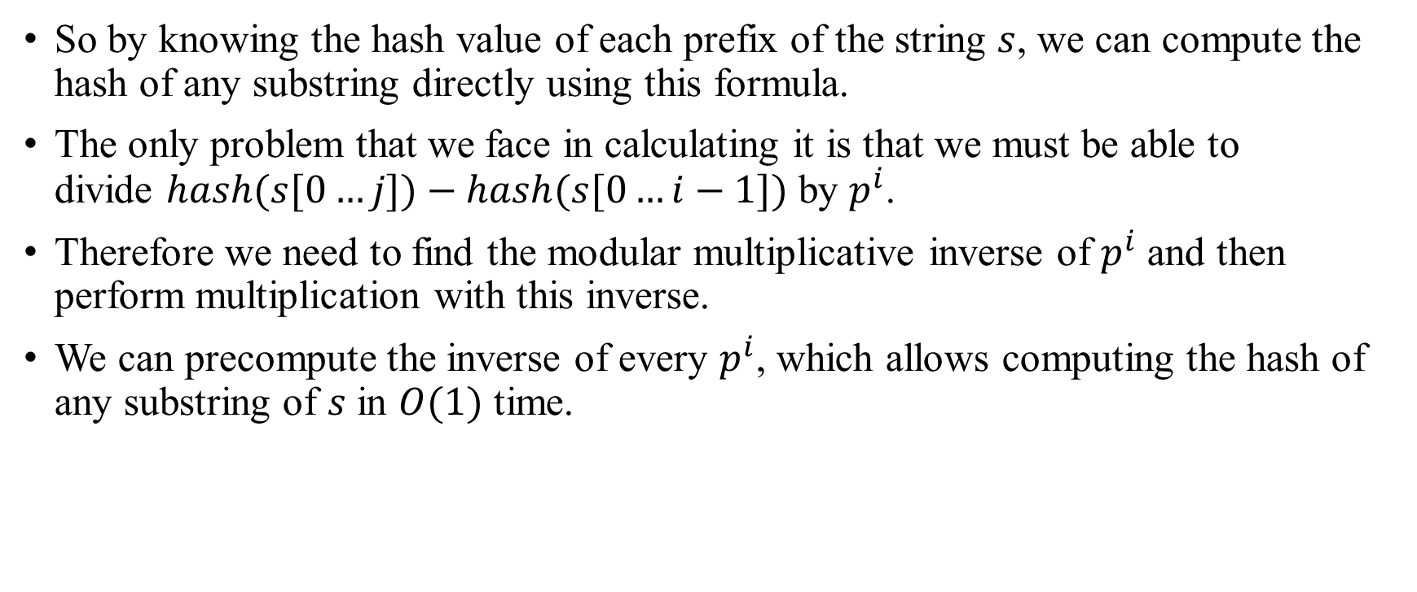
String hashing Fast hash of substrings of given string
So by knowing the hash value of each prefix of the string $s$, we can compute the hash of any substring directly using this formula.
The only problem that we face in calculating it is that we must be able to divide $hash(s[0…j])−hash(s[0…i−1])$ by $p^{i}$.
Therefore we need to find the modular multiplicative inverse of $p^{i}$ and then perform multiplication with this inverse.
We can precompute the inverse of every $p^{i}$, which allows computing the hash of any substring of $s$ in $O(1)$ time.

Slide 17
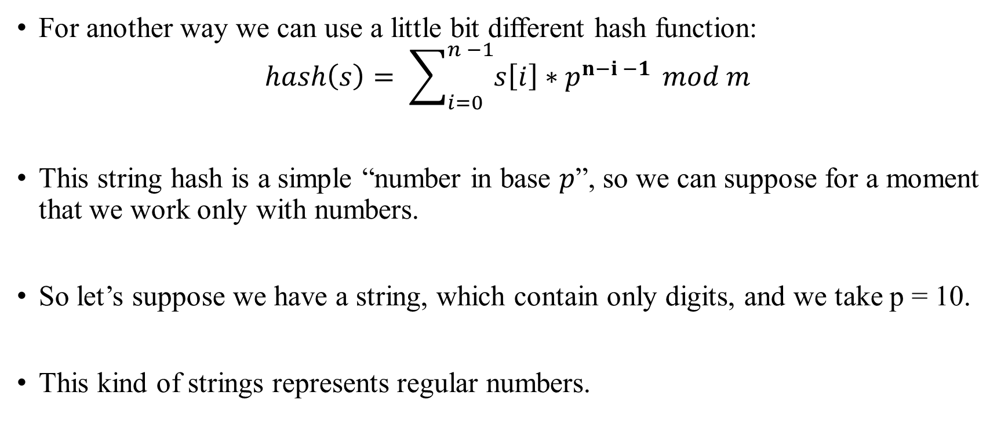
String hashing Fast hash of substrings of given string
For another way we can use a little bit different hash function:
$$hash\left(s\right)= \sum_{i=0}^{n −1}{s\left[i\right]∗p^{n−i −1}} mod m$$
This string hash is a simple “number in base $p$”, so we can suppose for a moment that we work only with numbers.
So let’s suppose we have a string, which contain only digits, and we take p = 10.
This kind of strings represents regular numbers.

Slide 18
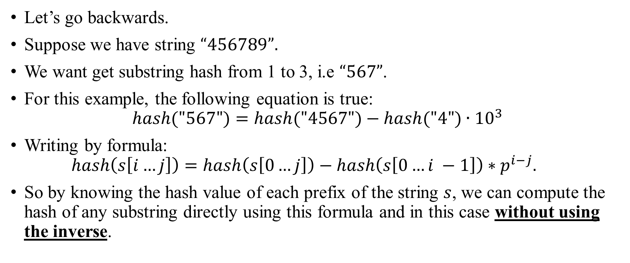
String hashing Fast hash of substrings of given string
Let’s go backwards.
Suppose we have string $“456789”.$
We want get substring hash from 1 to 3, i.e $“567”$.
For this example, the following equation is true:
$$hash("567")=hash("4567")−hash("4")∙{10}^{3}$$
Writing by formula:
$$hash\left(s\left[i…j\right]\right)=hash\left(s\left[0…j\right]\right)−hash\left(s\left[0…i −1\right]\right)∗p^{i−j}.$$
So by knowing the hash value of each prefix of the string $s$, we can compute the hash of any substring directly using this formula and in this case without using the inverse.

Slide 19
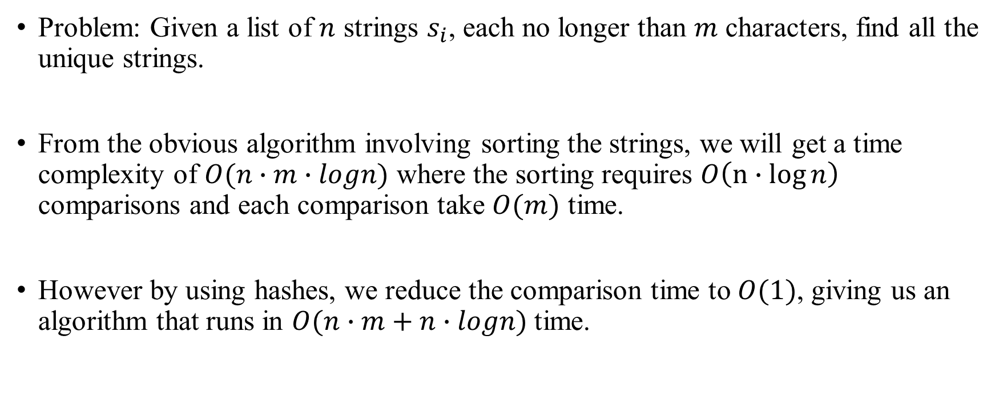
String hashing Search for unique strings in an array of strings
Problem: Given a list of $n$ strings $s_{i}$, each no longer than $m$ characters, find all the unique strings.
From the obvious algorithm involving sorting the strings, we will get a time complexity of $O(n∙m∙logn)$ where the sorting requires $O\left(n∙\log{n}\right)$ comparisons and each comparison take $O(m)$ time.
However by using hashes, we reduce the comparison time to $O(1)$, giving us an algorithm that runs in $O(n∙m+n∙logn)$ time.

Slide 20
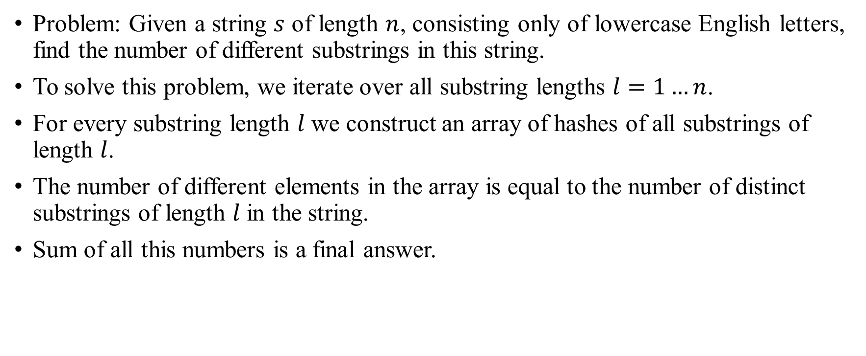
String hashing Find the number of different substrings in a string
Problem: Given a string $s$ of length $n$, consisting only of lowercase English letters, find the number of different substrings in this string.
To solve this problem, we iterate over all substring lengths $l=1…n$.
For every substring length $l$ we construct an array of hashes of all substrings of length $l$.
The number of different elements in the array is equal to the number of distinct substrings of length $l$ in the string.
Sum of all this numbers is a final answer.

Slide 21
Trie

Slide 22
Trie
A trie or prefix tree is a tree-like data structure whose nodes store the letters of an alphabet.
By structuring the nodes in a particular way, words and strings can be retrieved from the structure by traversing down a branch path of the tree.
Using a trie are a common approach to the storing/searching strings problem.
There are only 3 operations, that we can perform on tries:
Adding, finding and removing the strings.

Slide 23
Trie Inner representation
A trie usually contains a structure named Node. Node by itself contains an array of Node-s and some another useful variables.
In this example trie contains strings “ac” and “zyb”.
root
a
b
c
y
z
a
b
c
y
z
a
b
c
y
z
a
b
c
y
z
a
b
c
y
z
a
b
c
y
z

Slide 24
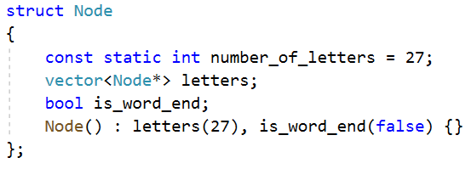

Trie Node structure
Node contains array of $k$ Nodes, where k is a number of letters in alphabet.
Possible implementation can be the following:

Slide 25
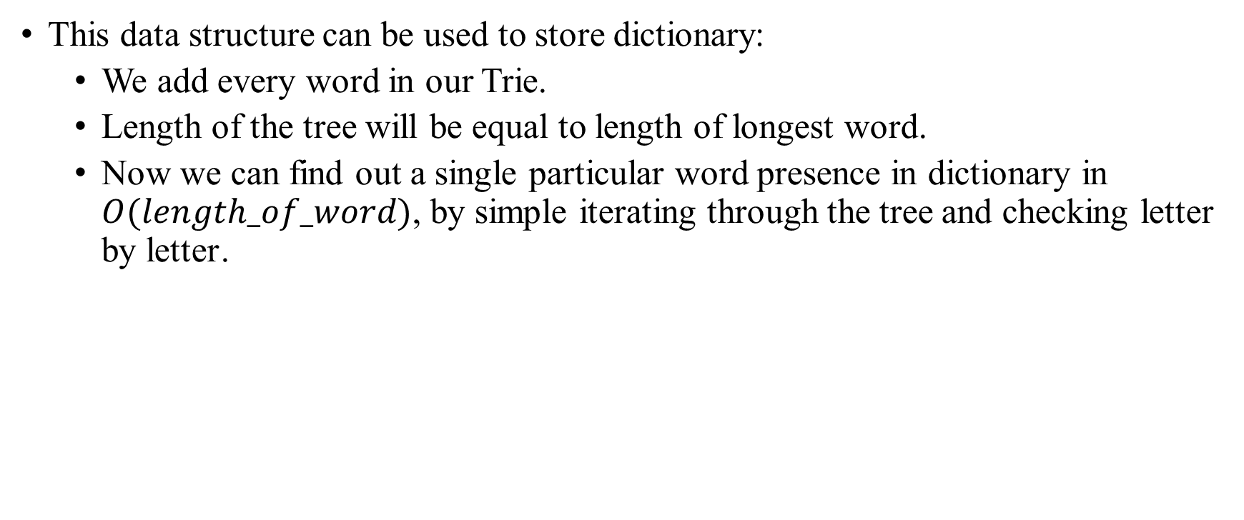
Trie Examples: Dictionary
This data structure can be used to store dictionary:
We add every word in our Trie.
Length of the tree will be equal to length of longest word.
Now we can find out a single particular word presence in dictionary in $O(length_of_word)$, by simple iterating through the tree and checking letter by letter․

Slide 26
Trie Other examples
Also this data structure can be used to:
Autocomplete the word by it’s prefix.
Find the words by substring.
Spell checking.
Automatic command completion.

Slide 27
Thanks for listening ։)

